Slide 1
Storm Surge
How Hurricanes Affect Local Economies
The Dream Team
Chris, Brandon, Anna & Brunia
GIF Image

Slide 2
Executive Summary
Industry: Environmental Science and Real Estate
Project Goal: Determine the impact that hurricanes have on local economies
Questions:
Which areas are most affected by hurricanes?
How are home prices affected?
How are jobs and income affected?
Hypothesis:
Southern states with warmer climates receive more hurricane landfalls.
Hurricane strikes likely increase the cost of homeownership, though not permanently
Hurricanes likely result in a temporary increase in jobs and income.

Slide 3
Data Sources
Data was sourced from:
The Federal Housing Finance Agency
The National Hurricane Center
The National Oceanic and Atmospheric Administration
The Bureau of Economic Analysis

Slide 4
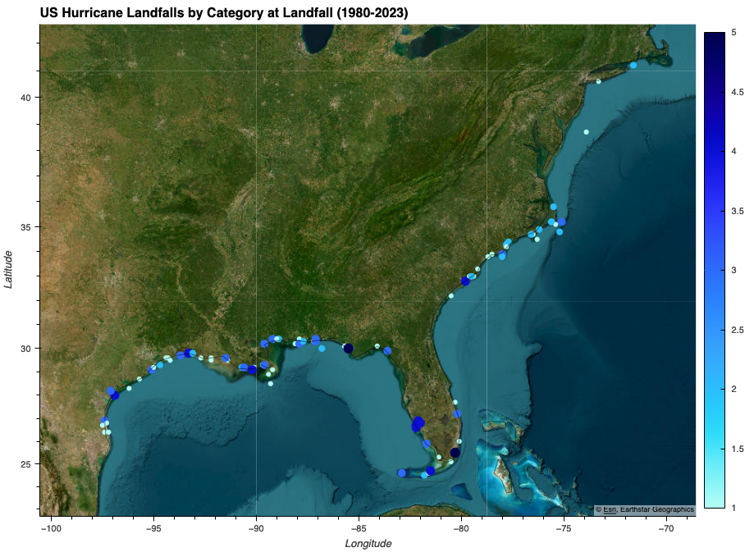
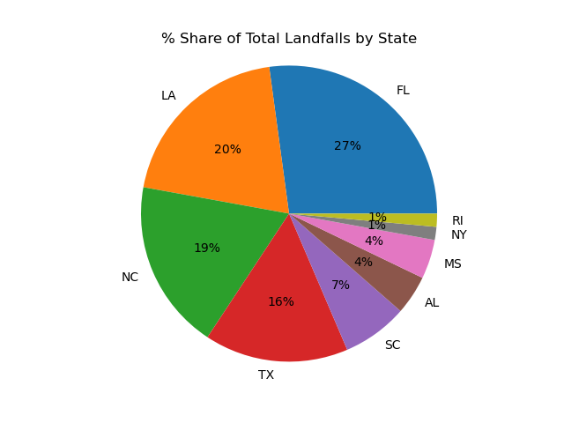
Which states are most affected by hurricanes?
Image: Escri Imagery of Hurricane landfall

Slide 5
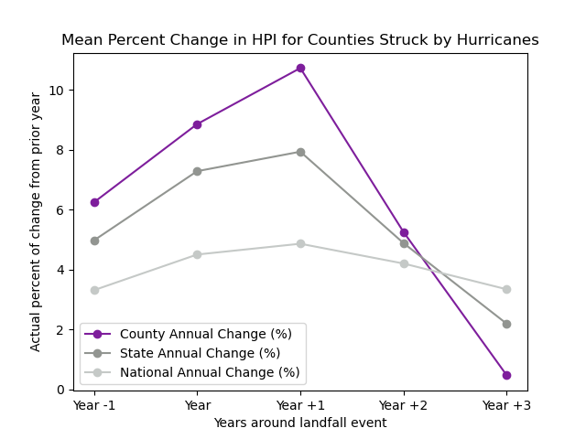
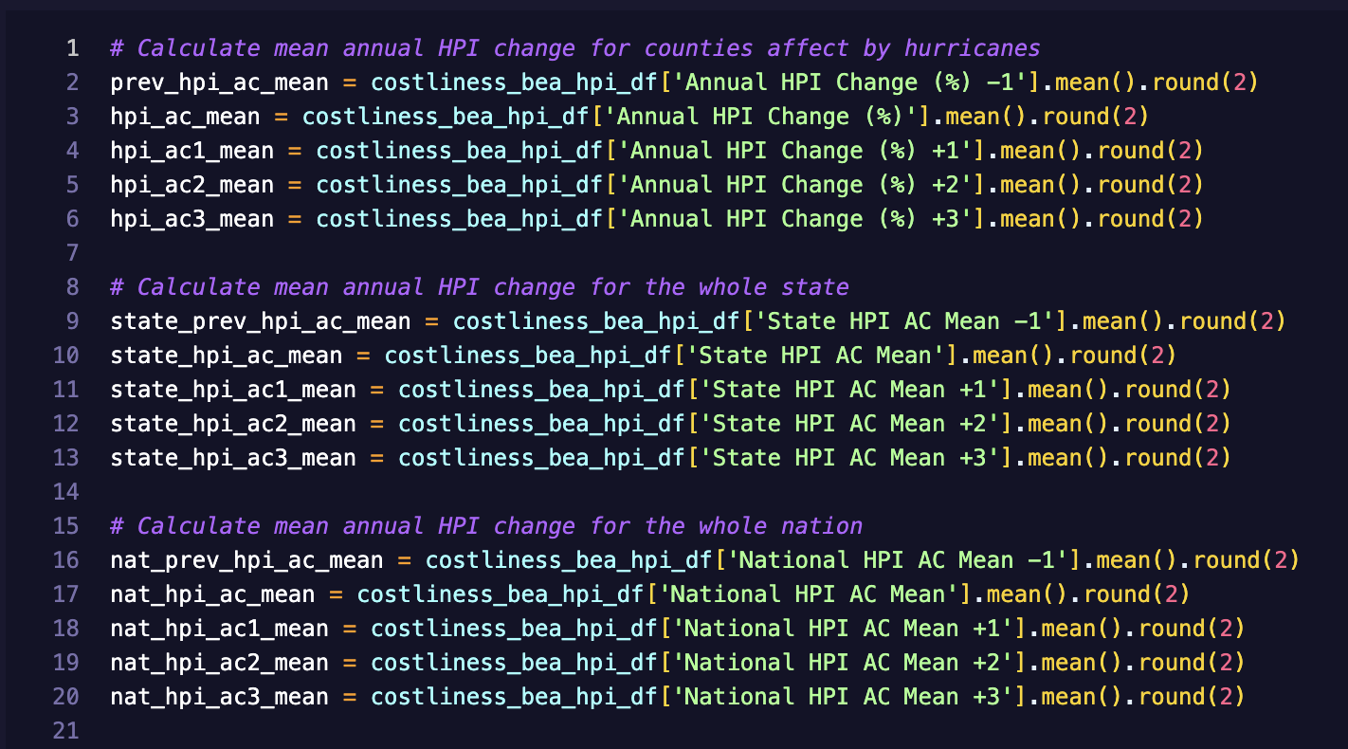
How are housing price indexes (HPI) affected by hurricanes?

Slide 6
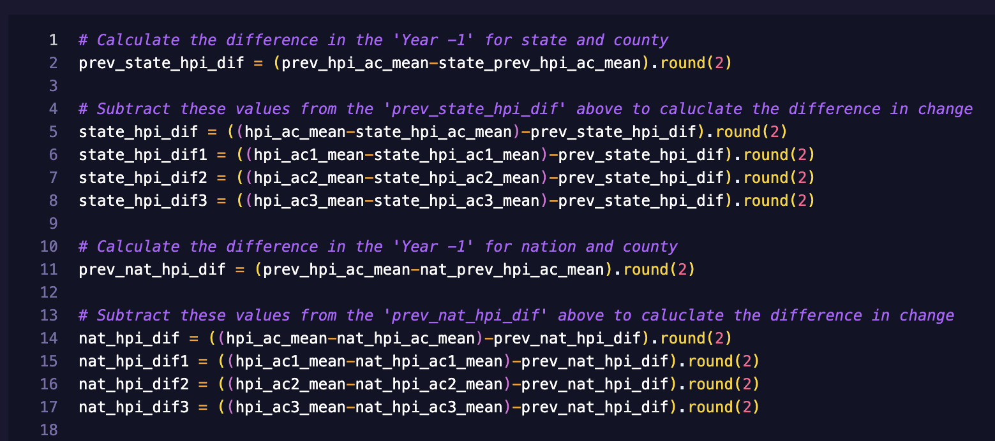
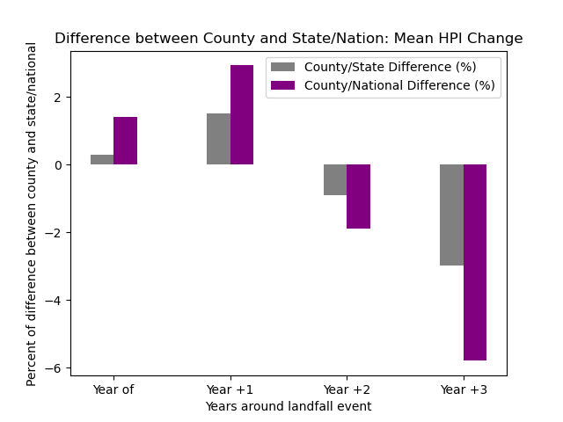
Comparing state and national standards

Slide 7
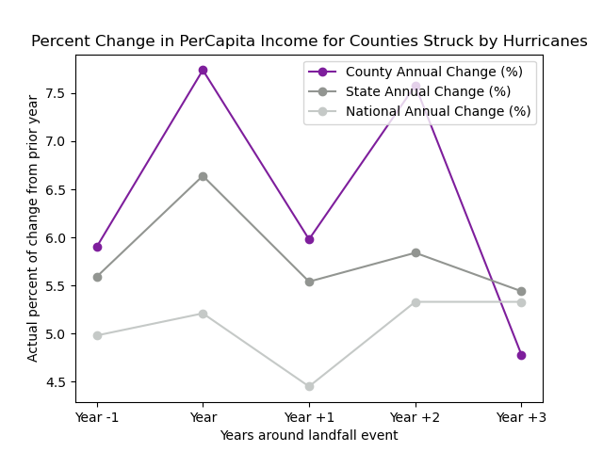
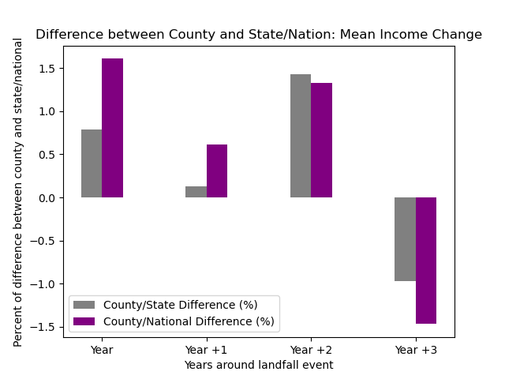
How is income affected?

Slide 8
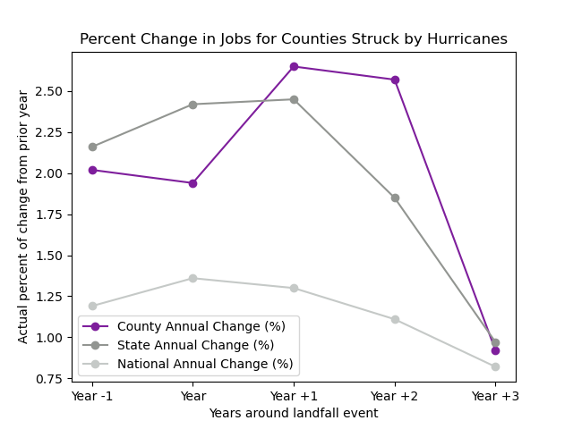
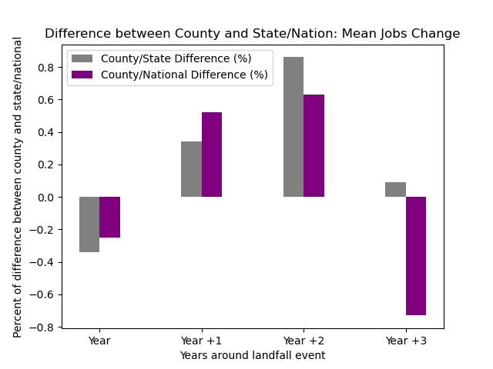
How are jobs affected?

Slide 9
Data Analysis Findings/Conclusions
Florida gets the majority of hurricane strikes in the US at 27%
Hurricanes cause the cost of housing to rise for the immediate years following the event, but it balances out after a few years.
Income is only slightly affected by hurricanes; only a 1-1.5% difference is observed between the county and the nation.
Jobs increase in the aftermath of a hurricane, but this also balances out after a few years.

Slide 10
Next Steps:
Retrieve data from more years ahead and before.
Assess how much federal funding went to affect areas.
Get a better overall picture of the economy.

Slide 11
References:
FHFA Housing Price Index data: https://www.fhfa.gov/data/hpi/datasets
Hurricanes by costliness: https://www.ncei.noaa.gov/access/billions/dcmi.pdf
List of US hurricane landfalls: https://www.aoml.noaa.gov/hrd/hurdat/UShurrs_detailed.html
Bureau of Economic Analysis:
Chart for per capita income for every County 1980-2023: https://apps.bea.gov/api/data?&UserID={KEY}&method=GetData&datasetname=Regional&TableName=CAINC1&LineCode=1&Year=ALL&GeoFips=COUNTY&ResultFormat=json
Chart for total jobs for every county 1980-2023: https://apps.bea.gov/api/data?&UserID={KEY}&method=GetData&datasetname=Regional&TableName=CAINC30&LineCode=240&Year=ALL&GeoFips=COUNTY&ResultFormat=json

Slide 12
THE END
Any Questions?

